Slide 1
Titan Oil Recovery, Inc.
Organic Oil Recovery

Slide 2
Forward Looking Statement
This presentation contains forward-looking statements within the meaning of the Private Securities Litigation Reform Act of 1995. All statements included herein that address activities, events or developments that the Company expects, believes, intends, or anticipates will or may occur in the future, are forward-looking statements. Actual events may differ materially from those anticipated in the forward-looking statements. Although the Company believes that the assumptions underlying the forward-looking statements contained herein are reasonable, any of the assumptions could be inaccurate. There can be no assurance that the forward-looking statements included in this presentation will prove to be accurate. In light of the significant uncertainties inherent in the forward-looking statements included herein, the inclusion of such information should not be regarded as a representation by the Company that the objectives and expectations of the company will be achieved.

Slide 3
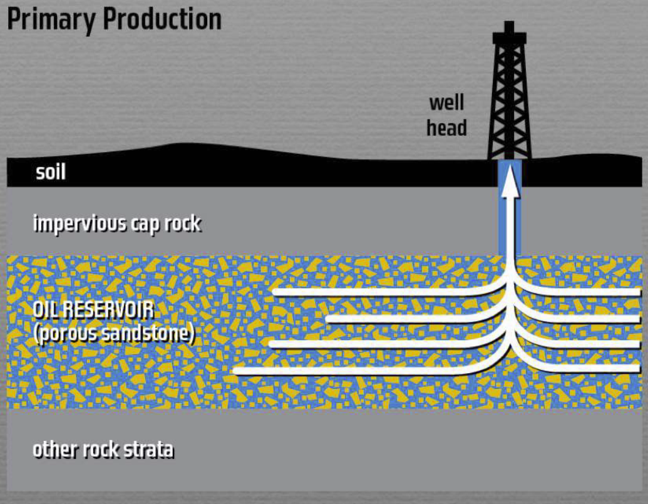
THE PROBLEM
65% of the World’s Oil in Existing Oil Fields is trapped
and cannot be recovered….
6.2 Trillion Trapped Barrels of Oil in Existing Oil Fields
Economic Value over $300 Trillion (T)

Slide 4
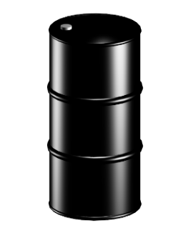
THE SOLUTION Titan Oil Recovery – Organic Oil Recovery
We Free Trapped Oil Using the Sciences of Nature
Proven - Proprietary - Eco Friendly - Low Cost
Average Well Production Increases 92% as a Result of The Titan Process

Slide 5
Global Results
48 Oil Fields
300 Well Applications
Average Production Increase 92%
Offshore and On Shore

Slide 6
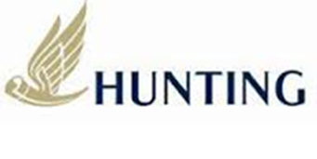
Business Model
Revenues from Service to Global Oil Operators
Charge $30,000-$400,000 per Well Treatment
Injection Wells: $500,000 to $3,500,000 Per Treatment
Well Treatments 2-3 Times Per Year
Cash Flow from Titan Owned Oil Fields
Joint Ventures with Halliburton for Investment Groups

Slide 7
Strategic Partner
Hunting Energy Services
Billion Dollar Oil Service Company

Slide 8
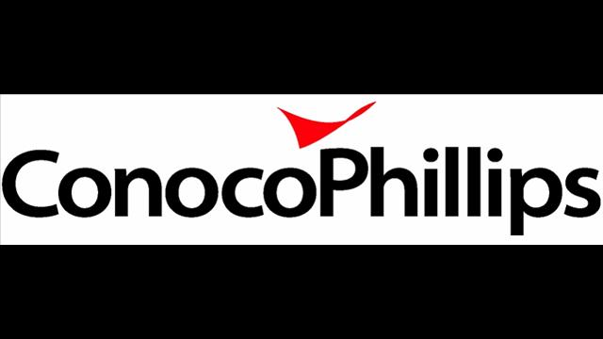
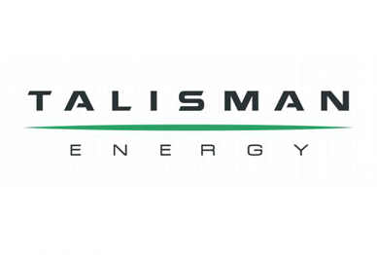
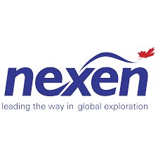
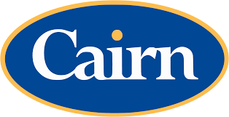
Customers

Slide 9
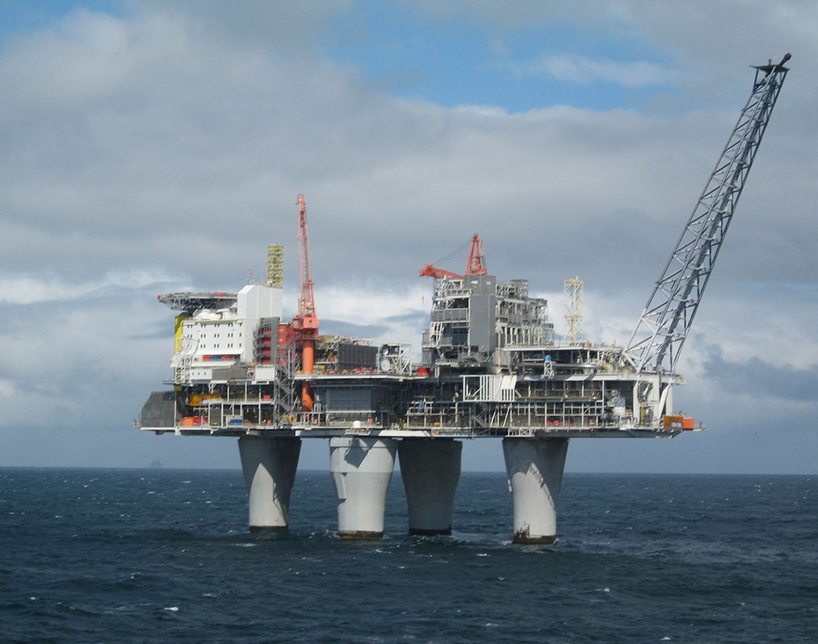
Offshore 6,500 Platforms in 53 Countries
Lack of Deck Space Prohibits Most Enhanced Oil Recovery
Platforms Closings Leaving Billions of Barrels of Oil
North Sea Platform Closings – One Every 3 Weeks
Gulf of Mexico Closings – One Every Other Day!
Decommission Cost: $100 million to $2 billion per Platform in North Sea

Slide 10
Titan Process Customer Benefits
Increases Oil production
Cost per Incremental Barrel: $6-$15 Barrel
Exceptional IRR
Faster
Cleaner
Biodegradable
Low Cost
No Capital Expense
Easy Implementation
Cash Flow Improves
Reserve Additions

Slide 11
Society of Petroleum Engineers Papers Published Dramatic Results Verified By Customers
SPE 124319 MEOR Success in Southern Saskatchewan : Husky Energy: Documents oil production increases of: 225%, 450%, 100% and 533% on various test wells.
SPE 129742 MEOR Success in Southern California: Venoco Inc.: Documents oil production increases of: 300%, 15%, 27%, and 752% on various well tests in Southern California
SPE 145054 What Has Been Learned From 100 MEOR Applications: Husky, Venoco, Titan Oil Recovery: 100 Applications documenting an average oil production increase of 127% from pre-treatment rates to post-treatment maximum rates.
SPE 154216 A Texas MEOR Application Shows Outstanding Production Improvement:
Atinum E&P, Inc. Documents oil production increases ranging from 25-90% with a dramatic
reduction of water cut.
These Papers were selected for presentation and officially approved for publication by: The Program Committee for the 2009 SPE Annual Technical Conference in New Orleans, Louisiana 4-7 October 2009; The Program Committee for the 2010 SPE Improved Oil Recovery Symposium in Tulsa, Oklahoma 24 -28 April 2010; The SPE Kuala Lumpur, Malaysia Enhanced Oil Recovery Conference July 2011; The SPE Tulsa Improved Oil Recovery Symposium April 2012.
11

Slide 12
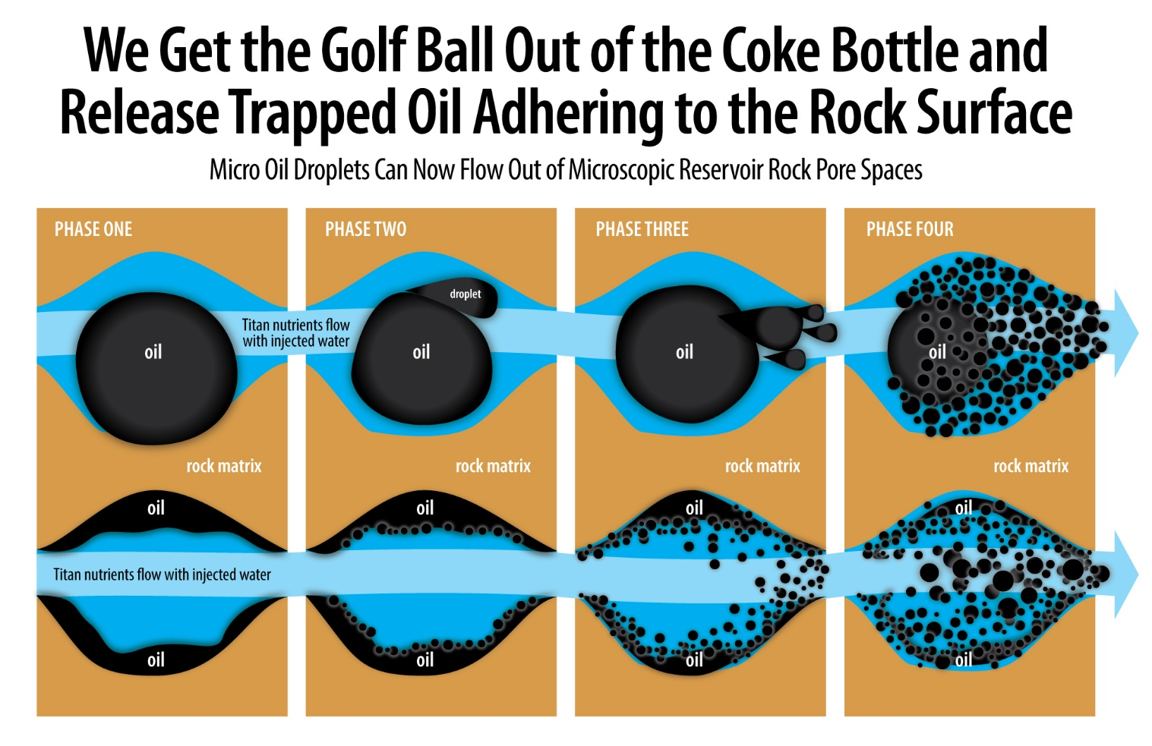

Slide 13
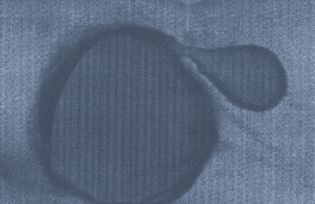
How the Technology Works Naturally Creating Micro Oil Droplets
Special Nutrients are injected in producing wells and injection wells to feed the trillions of microbes living in the reservoir
Certain resident microbes respond to the nutrients and change, wanting more oil on their skin. They then surround oil globules and distort the oil
The oil globules are now deformed and break into smaller droplets
Micro-droplets flow more freely through the reservoir rock and can be recovered from the reservoir
Microscopic photo below of actual real time microbial interaction with oil droplet.

Slide 14
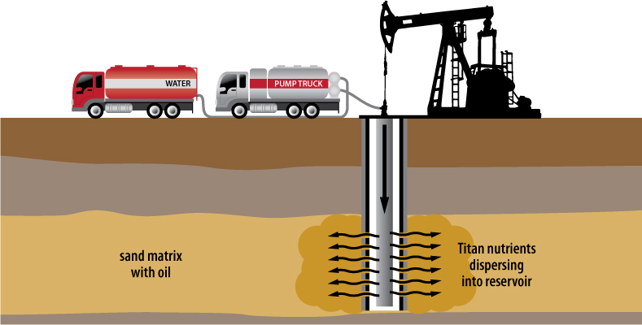
Simple Application

Slide 15
The Titan Process Easy to Get Started
1. Field Screening Simple Reservoir Questionnaire.
2. Laboratory Analysis The “Core” of the Process.
3. Field Test An In-field one well test process and analysis
4. Pilot Water injection system trial on multiple injectors servicing producing oil wells
5. Full Field Recovery We administer the process on field wide injection wells, dramatically increasing oil recovery
1 2 3 4 5

Slide 16
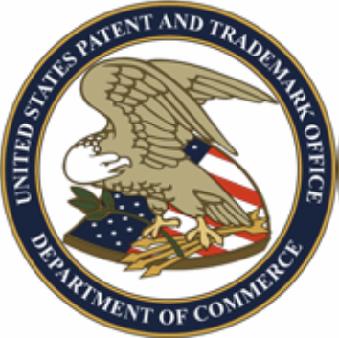
Valuable Patents 5 Granted 3 Pending
Permeability Modification: Granted
Gravity Assisted EOR: Granted
Tracer Technology for Fluid Flow: Granted
Carbonate Reservoir Recovery Breakthrough
Wettability Alteration
Low Salinity Enhancement Granted
Microbial Assisted Water and Gas Alternating: Granted
New Delivery of Nutrients

Slide 17
Trapped Oil U.S. Market Global Market $25 Trillion $300 Trillion

Slide 18
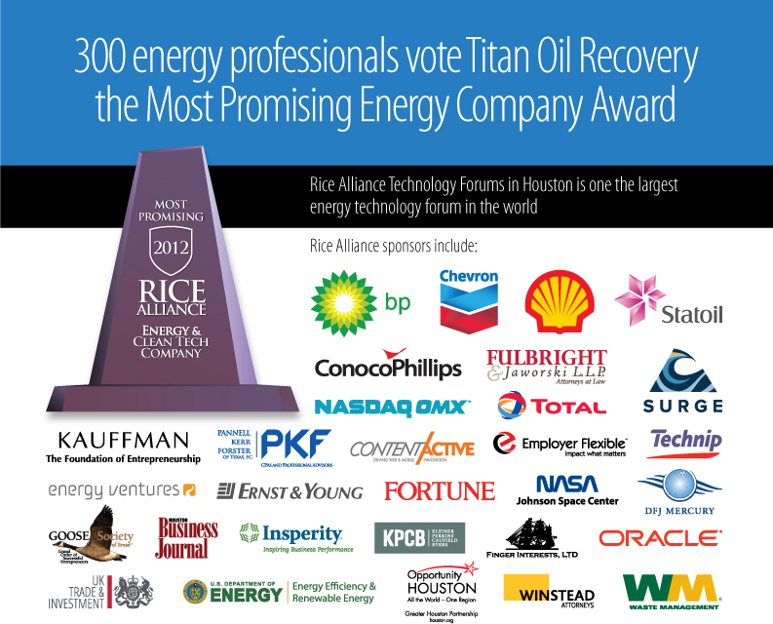

Slide 19
Financial Projections (Millions $)

Slide 20
Investment
$25,000,000
Marketing and Operations
Acquire Oil Properties

Slide 21
Use of Funds
USE OF FUNDS
Field Acquisition and Production
Field Acquisitions | $14,500,000 *
Acquisition and Divestiture Professionals (Landman, Engineers) | $780,000
Sub-Total | $15,280,000
Service Business & Management
G&A Expenses, Science and Technology, Field Operations | $2,100,000
Intellectual Property Purchase Payments | $3,917,481
Investment Banking, Consulting and Fees Associated with the Investment Raise | $2,500,000
Payables and Unreimbursed Business Expenses | $1,031,456
Sub-Total | $9,548,937
Contingency | $171,063
Total | $25,000,000
* Acquiring oil fields with 50% debt and 50% equity would equate to $29 million in acquisitions

Slide 22
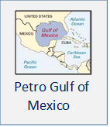
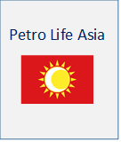
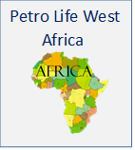
Alliance Companies Shareholders Distributed Shares in Two Separate Oil Service/Production Companies at no Cost, More Planned for the Future to Address the $300 Trillion Market
Titan Oil Recovery

Slide 23
Global Professionals Involved
Brian Marcotte – Former president of three major production countries for Unocal before the Chevron merger
Dr Alan Heeger - Nobel Laureate in Chemistry
Ron Harrell – Former CEO and Chairman of Oil Engineering and Consulting firm Ryder Scott and Senior Adviser to Carlyle Group and Morgan Stanley Energy Partners
Scot Evans – Currently Vice President of Halliburton’s Integrated Asset Management
Saad Turaiki - Ex-Chief Petroleum Engineer overseeing the management of all oil and gas fields in Saudi Aramco. Ex-Vice President managing all oil fields in Southern Region responsible for 6-7 million bbls of production per day
Sammy Hamzah- Vice Chairman of the Indonesian Petroleum Association, CEO of PT Ephindo Indonesia, Former Senior Vice President, Unocal Indonesia.
Bill Daily – Ex VP of Atlantic Richfield (world’s 7th largest oil company before being bought out by BP). In his last CEO position – his company was bought out for $3 billion.
Roger Lemons – CEO Petro Life, ex-Mgn. Dir. Jeffries, Ex. VP Winter Ridge Energy, 16 Years Unocal, Eng.
Gary Awad – Ex VP of Unocal – His last energy deal (Lead Board member) was bought out for $1.2 billion
Dr. Warren Kourt – Professor of Oil & Gas at Stanford University
Congressman Dan Burton – 15 Term former Member of U.S. Congress, Chm. of House Government Oversight Committee & Ranking Member of Foreign Affairs Committee; Chm. Sub Committee Europe.
Kenneth J. Gerbino – Involved with only two investment banking deals prior to Titan; Athena Gold which was bought out by Miramar Mining which then was bought out by Newmont Mining for $1.5 billion and Fortress Technology which was bought out by General Dynamics for $120 million.

Slide 24
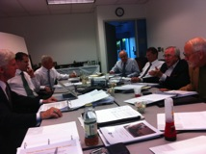
Board of Directors
Kenneth J. Gerbino, Chairman
Head of Kenneth J. Gerbino & Company, an investment management firm now in its 42nd year. Previously a Director of the Los Angeles Unified School District Annuity Reserve Board and Fortress Technologies, Inc. Former co-manager of the publicly traded mutual fund, The Growth & Income Fund. Founder and ex-Chairman of the American Economic Council, a nationwide economic reform group credited with the passage of the United States Gold Coin Act of 1984, establishing the U.S. Gold Eagle coin. Former member of the Senatorial Trust in Washington, D.C. Former financial analyst for Litton Industries and Republic Corporation. B.S. Ithaca College. MBA from Syracuse University.
Brian W. G. Marcotte, Director
Brian Marcotte has over 43 years of experience in the oil and gas industry ranging from technical positions to executive management. During his career with Unocal Corporation, he held the positions of: President Unocal Thailand, President Unocal Indonesia, President Unocal Netherlands, Corporate Vice President Public Policy, Health Environment and Safety, Vice President Unocal US Western Region, and Vice President of Technology and Asset Management. He served as Chairman of the Unocal Foundation. Mr. Marcotte has also served as President of the Board for the Indonesian Petroleum Association, Vice Chairman of the Petroleum Institute of Thailand’s Council of Trustees, member of the Thailand Development Research Institute, the Sasin Graduate School of Chulalongkorn University Advisory Council. Honored (2005) as a Distinguished Member of the Society of Petroleum Engineers. Ex- Chair the International Leadership Council of The Nature Conservancy. Board of Trustees of Marymount California University. He has a B.S. in Petroleum Engineering from the University of Southern California.

Slide 25
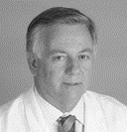
Board of Directors
Robert W. Carroll, Director
Chairman and CEO of the Biofriendly/Green Plus group. Active inventor, co-inventor of Green Plus® combustion catalyst. Co-inventor of the Vortoil oil-water separator system and other environmental products. Co-founder of BWN Automatic Doors, BWN Vortoil and Live Oil Services. The Vortoil oil-water separator won the Prince of Wales Award for innovation and later won the Queen’s Award for the best new technology introduced to the North Sea. It was stated that without the Vortoil oil-water separator the North Sea would not have been able to enjoy its high level production growth.
Dr. Colin Hill, Director
Emeritus Associate Professor of Microbiology, Radiation Oncology and Molecular Immunology, Keck School of Medicine of USC. Member Department of Energy Review Committees 1983-2005 Member NASA Review Committees 1983-2005, Chief Consultant Scientist for Biofriendly Corporation, Member Board of Editors of International Journal of Radiation Biology, Author of 176 Published Papers and Abstracts on various subjects having to do with cell organisms
John Sibert, III, Director
Dr. Sibert is a member of the Malibu California City Council and serves as Mayor. He is former Managing Director of Global Financial Group, ex-Manager of Research and Development for Atlantic Richfield. Division Administrator of the California Institute of Technology, Trustee of Claremont Graduate University, Consultant to NASA and Jet Propulsion Lab., Board of Governors of the National Coastal Resources Institute, Advisory Board of the Oceans and Atmosphere Association. Ex-Executive Director of the Alaska Science and Technology Foundation. Ph.D. University of California, San Diego.

Slide 26
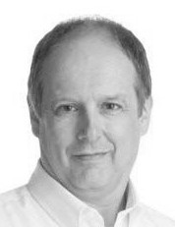
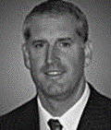
Board of Directors
Scot Evans, Director
Scot Evans is currently Vice President of Halliburton’s Integrated Asset Management Group, responsible for global oil and gas asset management for 11 producing properties. His 21 year experience with Halliburton includes development of business relationships with senior managements of National and International Oil Companies. He has 32 years experience in the oil & gas industry from his past positions at Exxon. He is a specialist in Mature Field Development and Asset management. His international experience includes Africa, Asia, Europe and Latin America.
Michael T. Carroll, Director
Mr. Carroll has most recently served as Vice President of Technology for LOSL (now merged with Titan) and Senior Vice President Operations for Biofriendly Corporation. He also serves as CEO and Chairman of the Board of Helio Environmental Solutions, an alternative energy company bringing zero-emission energy to market. He previously served as Vice President Sales and Marketing for Biofriendly Corporation and was a Senior Project Engineer for Peck/Jones Construction. Mr. Carroll holds a Bachelor of Science in Construction Management from California Polytechnic, San Luis Obispo.

Slide 27
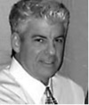
Management Team
Kenneth J. Gerbino, Founder, Chairman and acting CEO
President of Kenneth J. Gerbino & Company – Investment managers 43 years
Previously Director of the Los Angeles Unified School District Annuity Board, Athena Gold Corp and Fortress Technologies
Founder & Ex Chm. of the American Economic Council, credited with passage of the US Gold Coin Act of 1984.
Former Financial Analyst for Litton Industries and Republic Corporation. B.S. Ithaca College, MBA Syracuse Univ.
Professor Colin Hill , Vice President and Senior Scientist
Emeritus Associate Professor of Microbiology, Radiation Oncology and Molecular Immunology, Keck School of Medicine of USC.
Member Department of Energy Review Committees 1983-2005
Member NASA Review Committees 1983-2005
Chief Consultant Scientist for Biofriendly Corporation
Member Board of Editors of International Journal of Radiation Biology
Author of 176 Published Papers and Abstracts on various subjects having to do with cell organisms

Slide 28
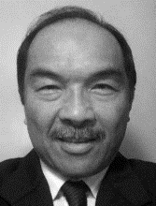
Management Team
Michael T. Carroll, Managing Director of Operations Mr. Carroll has most recently served as Vice President of Technology for LOSL (now merged with Titan) and Senior Vice President Operations for Biofriendly Corporation. He also serves as CEO and Chairman of the Board of Helio Environmental Solutions, an alternative energy company bringing zero-emission energy to market. He previously served as Vice President Sales and Marketing for Biofriendly Corporation and was a Senior Project Engineer for Peck/Jones Construction. Mr. Carroll holds a Bachelor of Science in Construction Management from California Polytechnic, San Luis Obispo
Steven P. Ramones, Controller
30 year career in the oil and gas industry – accounting & planning
Positions at Unocal included:
Responsible for implementing accounting policies and procedures for Unocals U.S. and international business units.
Responsible for financial reporting of environmental liabilities
Audits and information systems, Company-wide financial and income tax forecasts
B.S. Accounting Cal Sate Long Beach, MBA, UCLA

Slide 29
Advisory Board
Dr. Alan J. Heeger
Dr. Heeger is the recipient of the Nobel Prize in Chemistry 2000 for his research and discoveries in the field of conductive polymers. He is currently Professor of Physics and Professor of Materials at the University of California, Santa Barbara. Dr. Heeger has 60 issued patents and has written over 600 professional articles for leading scientific publications. He was Founder, Chairman, and President of UNIAX Corporation. Dr. Heeger has been the recipient of many prestigious Honorary Degrees at leading domestic and international colleges and universities.
Gareth C. C. Chang
Mr. Chang has served on the Board of Directors of Apple Computer, Palm, Inc., and Agile Software, and has been a member of Nike’s Advisory Board. He brings more than 30 years of international business experience to Titan’s Advisory Board with a special emphasis on China. Mr. Chang is Former Chairman and CEO of News Corporation’s STAR TV, Senior Vice President of Hughes Electronics Corporation, President of Hughes Electronics International, Chairman of Hughes JVC Technology, Corporate Vice President of McDonnell Douglas Corporation, and founding Chairman of McDonnell-Shanghai Aviation Executive Management Board. He was named one of the “125 Thinkers of the World” by Forbes magazine.

Slide 30
Contact: Kenneth J. Gerbino
Titan Oil Recovery, Inc.
9595 Wilshire Blvd., Suite 303
Beverly Hills, California
90212
310 281 0015
kgerbino@titanoilrecovery.com
www.titanoilrecovery.com

